Slide 1
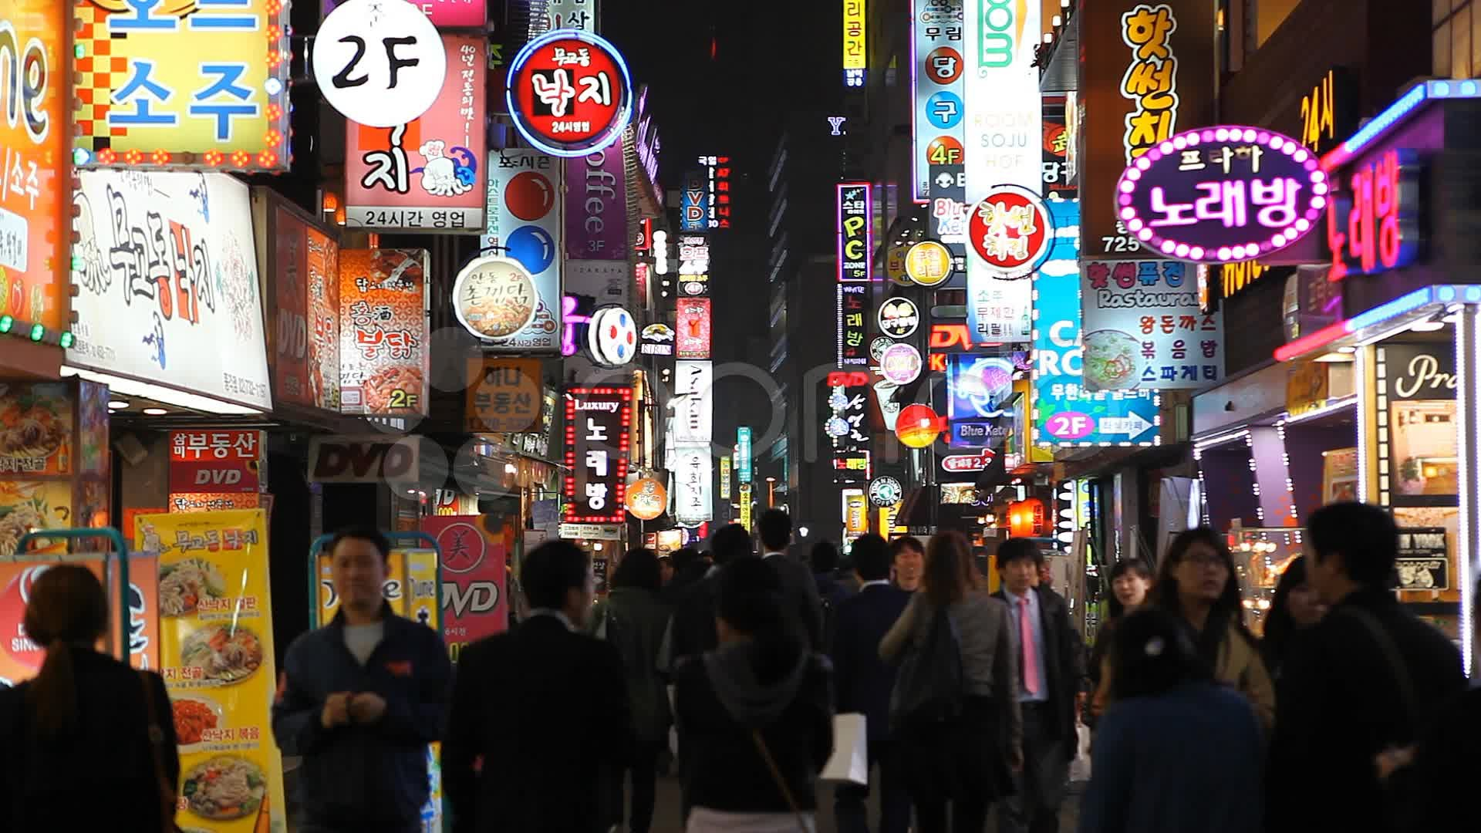

OPPCAST
Exploiting Spatial and Channel Diversity for Robust Data Collection in Urban Environments
Mobashir Mohammad
Xiang Fa Guo
Mun Choon Chan
IPSN 2016
Mobashir Mohammad | NUS
Oppcast

Slide 2
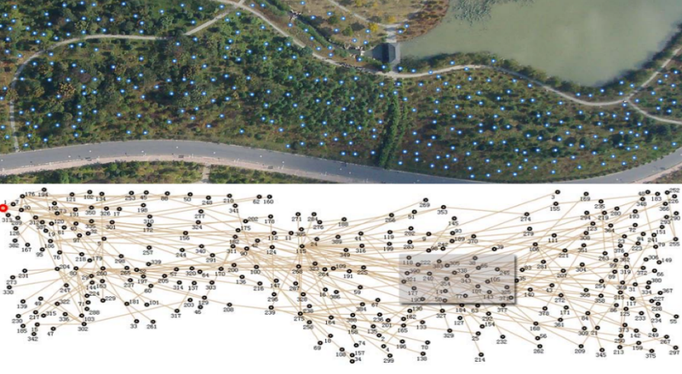
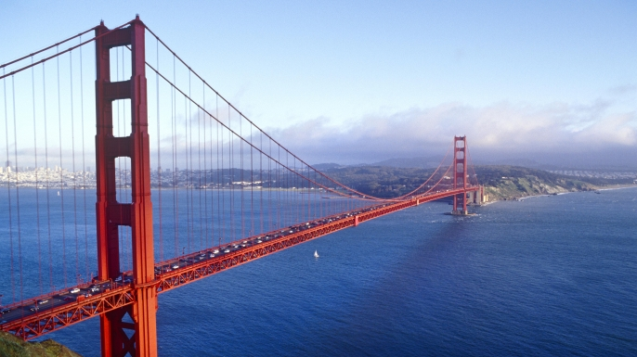
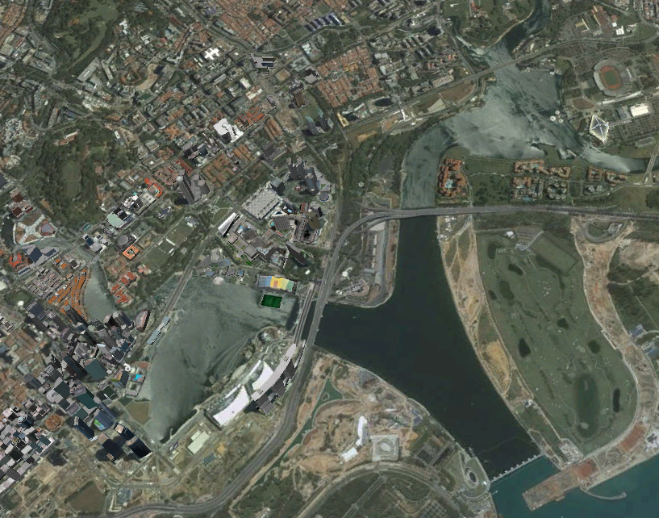
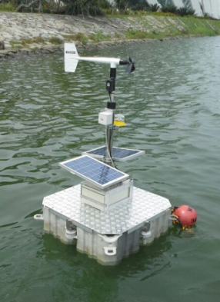
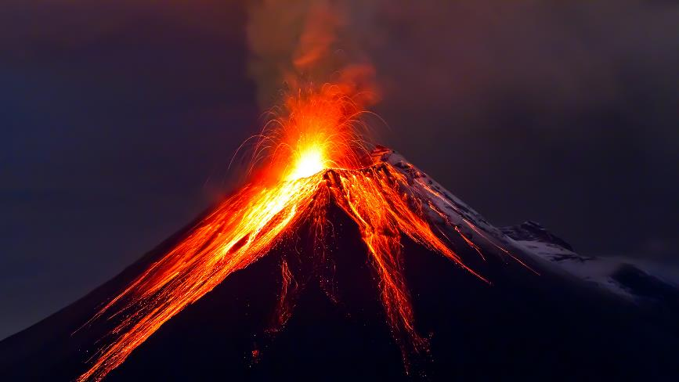

Some WSN Deployments
GreenOrbs [Y. Liu et al.]
Golden Gate Bridge [S. Kim et al.]
Water Reservoir [W. Du et al.]
_{3km}
Volcano [G. Werner-Allen et al.]
_{1 km}
ZebraNet [T. Liu et al.]
_{2.5km}
IPSN 2016
Mobashir Mohammad | NUS
Oppcast
Notes:
If we look back, we can recall some amazing wireless sensor network deployments. Some of them are deployments in the forest like Greenorbs, or on the Golden gate bridge for its structural monitoring.

Slide 3




Some WSN Testbeds
IPSN 2016
Mobashir Mohammad | NUS
Oppcast
Notes:
Besides them, there are some large scale testbeds like Indriya, bla bla deployed inside research labs and academic institutions.
However, one thing to notice is that in all these deployments, the interference is either not there, or controlled…

Slide 4
Urban Environments
Food Streets
IPSN 2016
Mobashir Mohammad | NUS
Oppcast
Notes:
What we quite often ignore is the environment around us.. Places where we live or quite often visit.

Slide 5
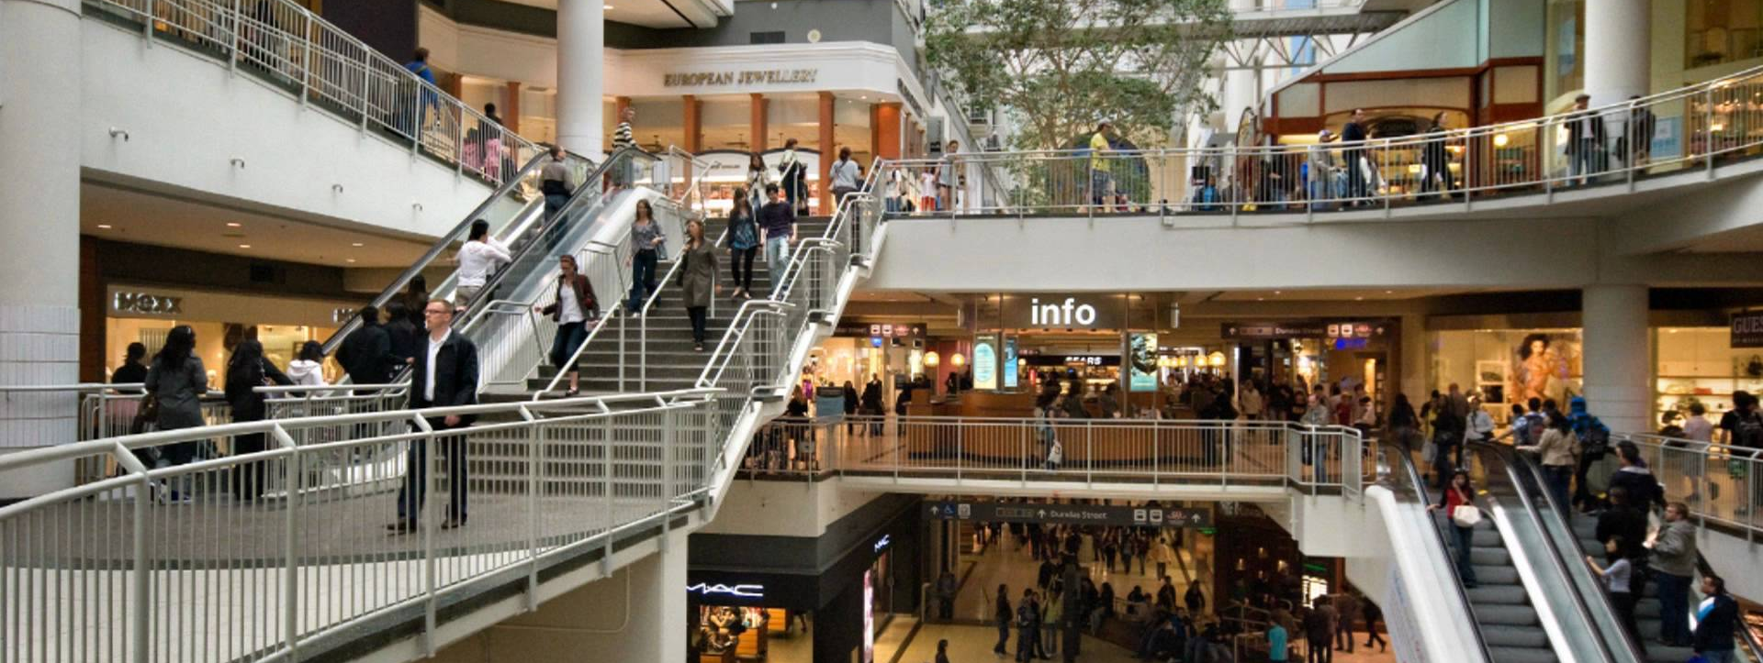
Urban Environments
Shopping Malls
IPSN 2016
Mobashir Mohammad | NUS
Oppcast

Slide 6
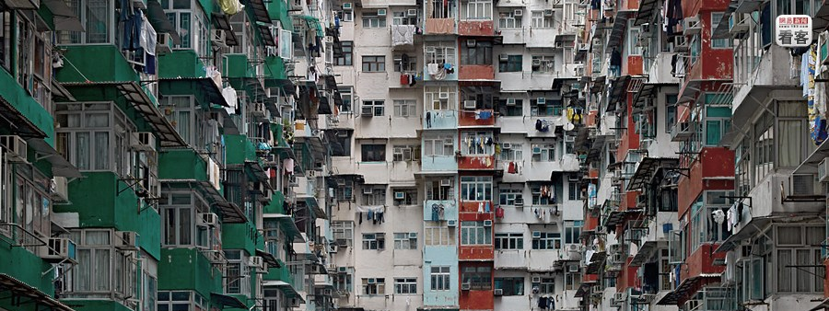
Urban Environments
Residences
IPSN 2016
Mobashir Mohammad | NUS
Oppcast

Slide 7

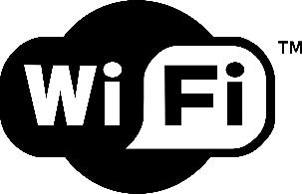

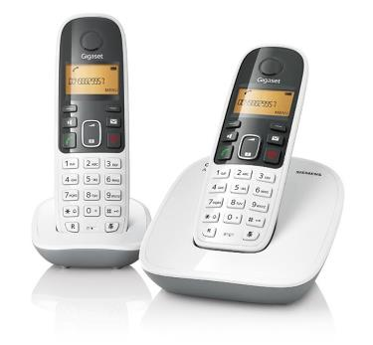
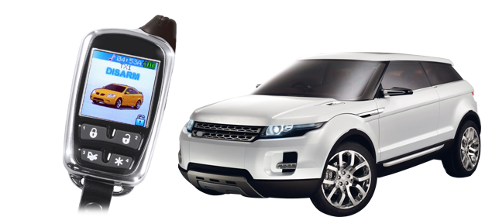
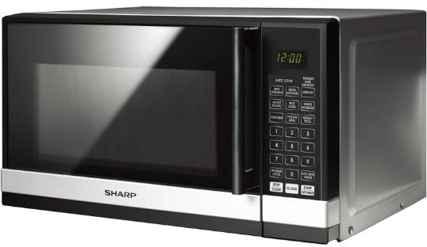
Urban Environments
Severe cross-technology interference (CTI)
IPSN 2016
Mobashir Mohammad | NUS
Oppcast
Notes:
All of these urban settings suffer from severe cross-technology interference…
Microwave: http://www.comparison.com.au/system/image_library/34769/sharp_r240ys_microwave_oven.jpg?1319523819
Cordless Phone: http://stat.homeshop18.com/homeshop18/images/productImages/474/siemens-gigaset-cordless-phone-a490-duo-white-large_fc6819f3217a439bfc12cd0edc547391.jpg
Car Alarm: http://cdn.toptenreviews.com/rev/site/cms/category_headers/675-h_main-w.png

Slide 8
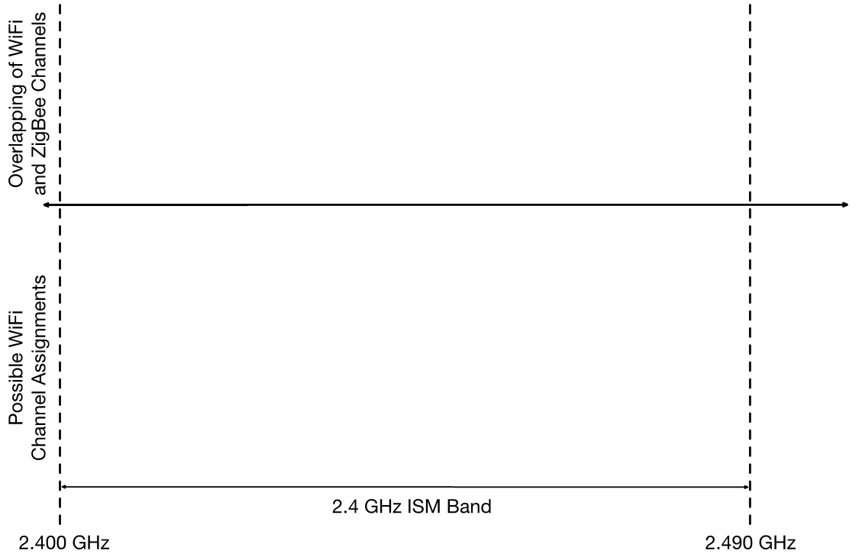
Cross-Technology Interference
IPSN 2016
Mobashir Mohammad | NUS
Oppcast
Notes:
If we just talk about WiFi, the most prevalent source of interference in an urban environment….

Slide 9
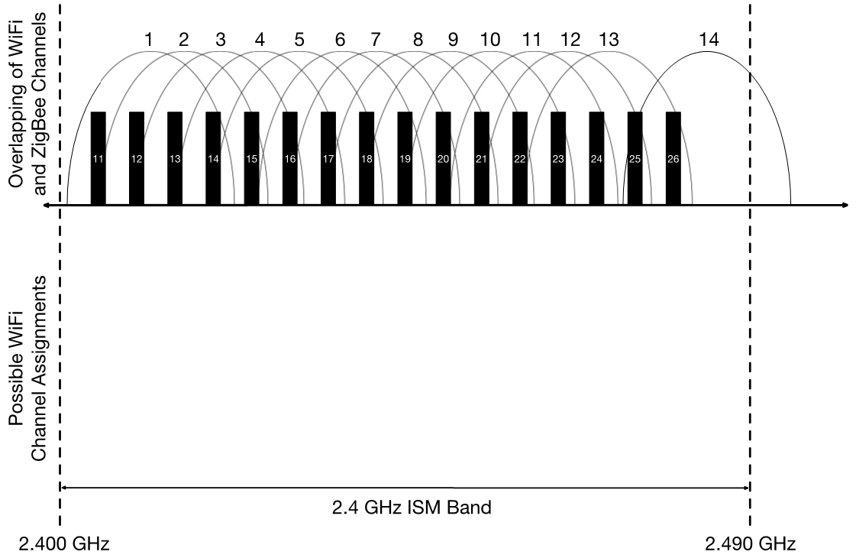
Cross-Technology Interference
WiFi Channels
ZigBee Channels
IPSN 2016
Mobashir Mohammad | NUS
Oppcast
Notes:
We all know how much the overlap with ZigBee…

Slide 10

Cross-Technology Interference
WiFi Channels
ZigBee Channels
Possible Channel Assignment Strategies
IPSN 2016
Mobashir Mohammad | NUS
Oppcast
Notes:
Given that there are many possible WiFi channel assignment strategies,

Slide 11
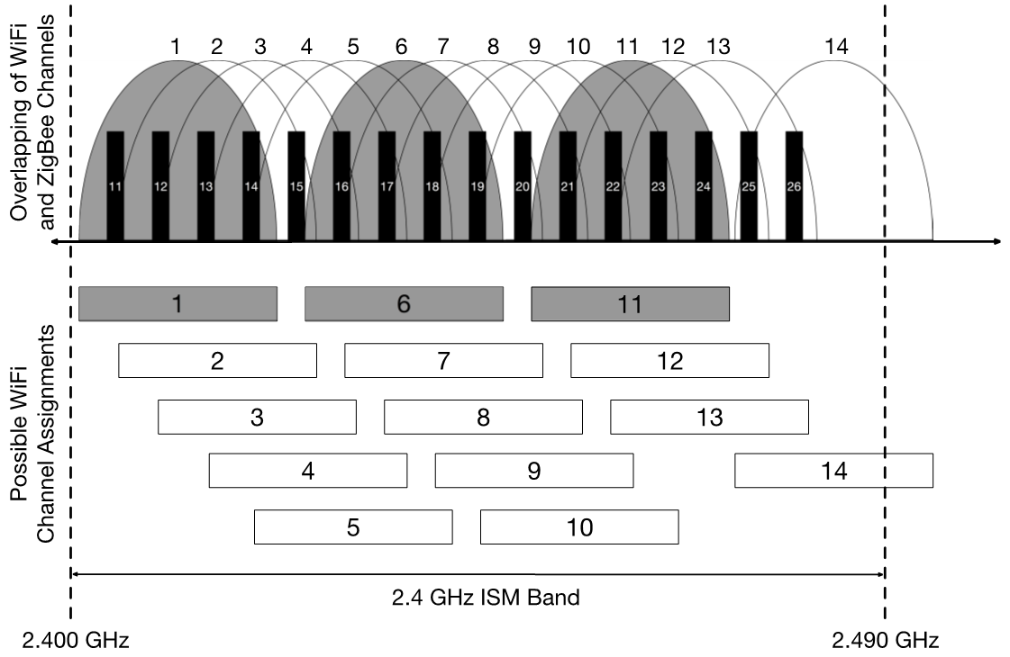
Cross-Technology Interference
WiFi Channels
ZigBee Channels
Possible Channel Assignment Strategies
IPSN 2016
Mobashir Mohammad | NUS
Oppcast
Notes:
We often assume that we have at least 4 ZigBee channels orthogonal to the most common WiFi channel assignment.s

Slide 12
Cross-Technology Interference
WiFi Channels
ZigBee Channels
Possible Channel Assignment Strategies
IPSN 2016
Mobashir Mohammad | NUS
Oppcast

Slide 13
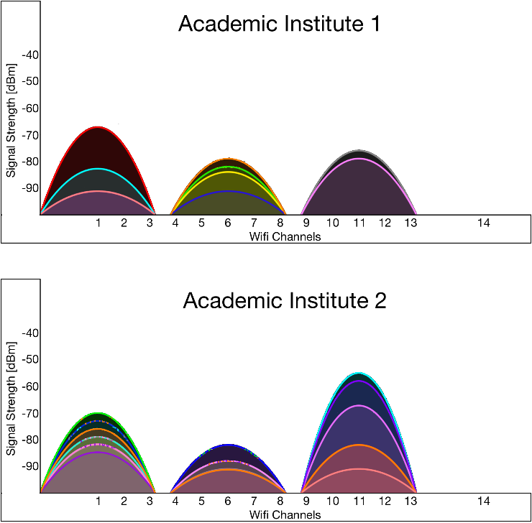

Cross-Technology Interference Pattern
PLANNED CTI
IPSN 2016
Mobashir Mohammad | NUS
Oppcast

Slide 14
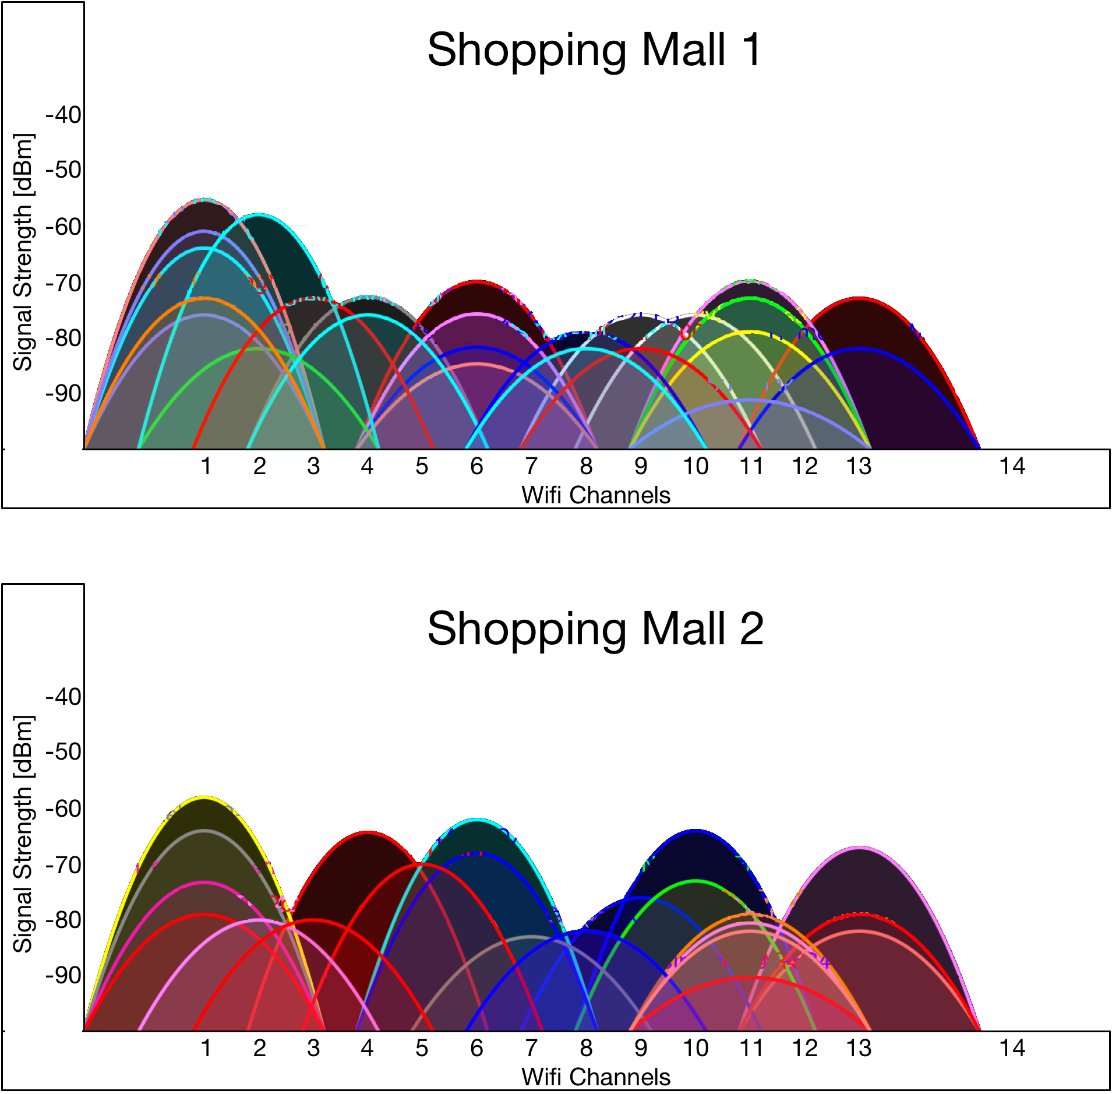
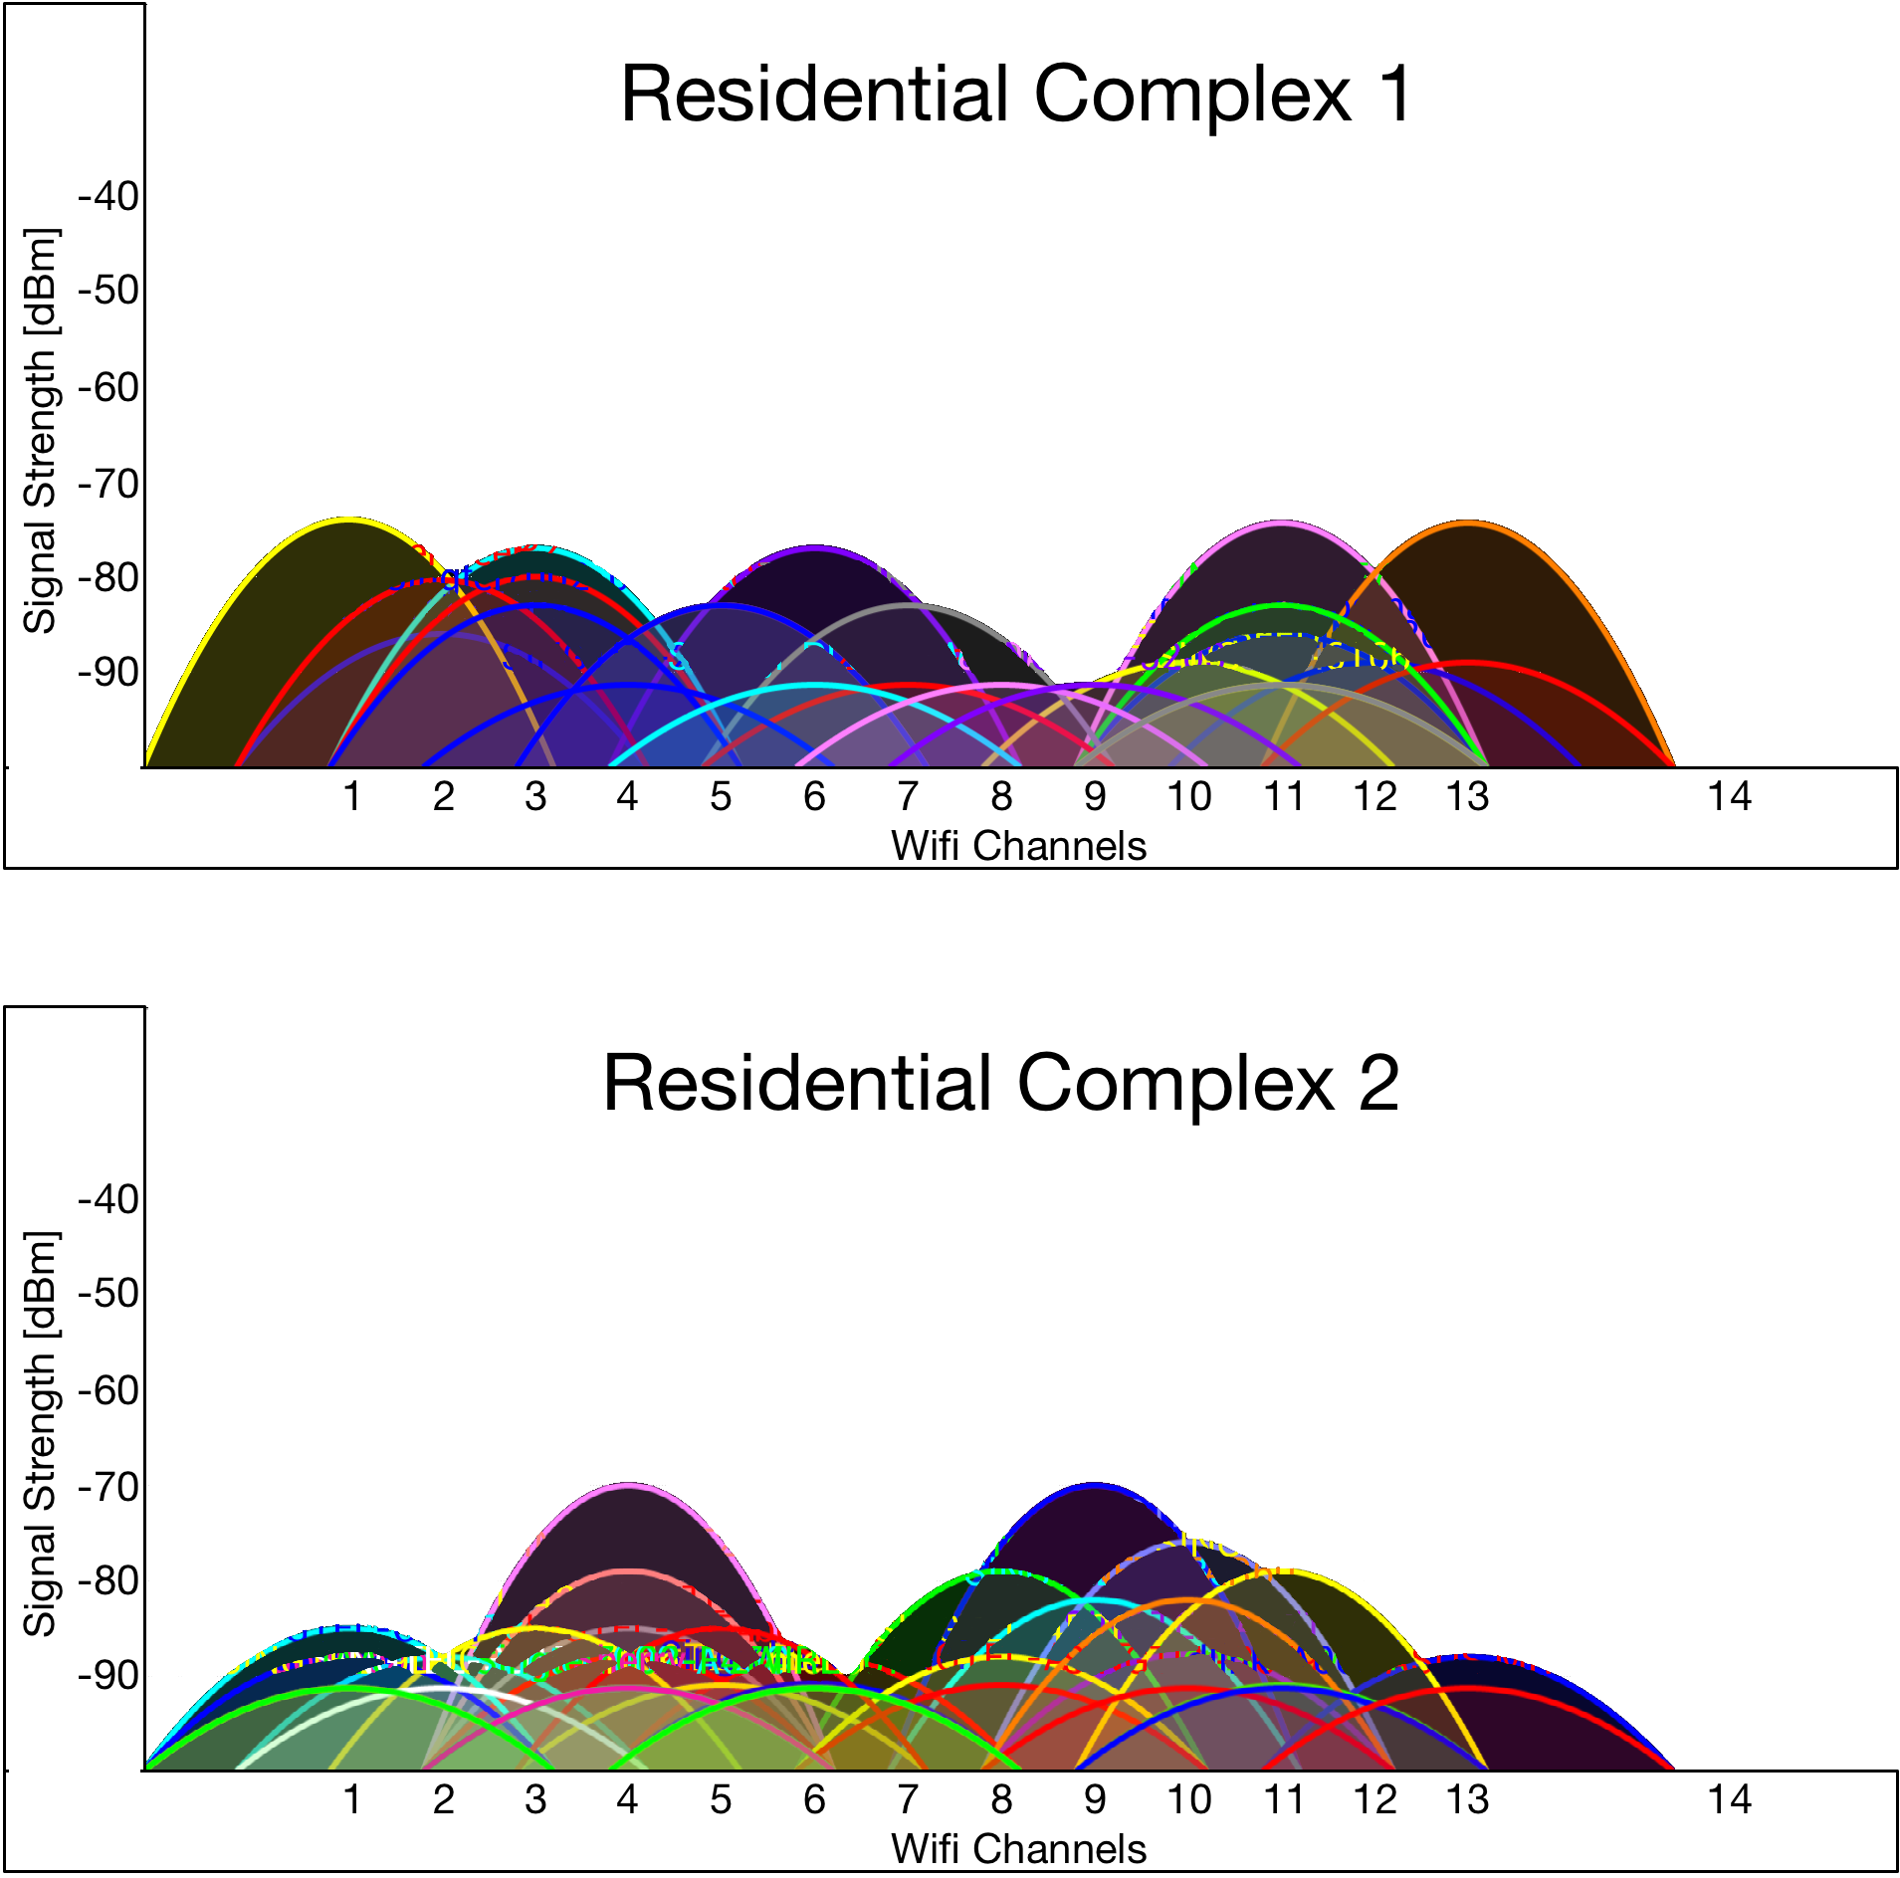
Cross-Technology Interference Pattern
UNPLANNED CTI
IPSN 2016
Mobashir Mohammad | NUS
Oppcast

Slide 15
Cross-Technology Interference Pattern
UNPLANNED CTI
Key Observations
Many countries allow unrestricted use of all WiFi channels
One cannot rely on expensive channel quality estimations
Predicting CTI is almost impossible
A “good” channel now may not be “good” the next moment
A “good” channel may not be “good” for the entire network
IPSN 2016
Mobashir Mohammad | NUS
Oppcast

Slide 16
Cross-Technology Interference Pattern
Nodes
geographically close
ZigBee Channel 26 scanned @ 8KHz
outside a shopping mall
Nodes
geographically far
IPSN 2016
Mobashir Mohammad | NUS
Oppcast

Slide 17
Cross-Technology Interference Impact
Number of Neighbors on Interference free Channel
~16
IPSN 2016
Mobashir Mohammad | NUS
Oppcast

Slide 18
Cross-Technology Interference Impact
Number of PRR>0.9 Neighbors on Interfered Channel
~2
IPSN 2016
Mobashir Mohammad | NUS
Oppcast

Slide 19
Cross-Technology Interference Impact
Number of PRR>0.9 Neighbors on Interfered Channel
Around 3.5X increase
in the
communication opportunities
~7
Multiple Channels
Many neighbors
IPSN 2016
Mobashir Mohammad | NUS
Oppcast

Slide 20
Oppcast
IPSN 2016
Mobashir Mohammad | NUS
Oppcast
Notes:
This brings us to Oppcast. With respect to other protocols that have been designed in the past, Oppcast tries to fill in the gap in the top right…!

Slide 21
Oppcast
Key Techniques
Eliminate channel quality estimation
Reduce Energy Consumption
Exploit channel diversity
Better Resilience to CTI
Exploit spatial diversity
Reduce end-to-end latency
IPSN 2016
Mobashir Mohammad | NUS
Oppcast
Notes:
And we do so by incorporating three different techniques, each having different yet equally important goals…

Slide 22
Oppcast
Key Techniques
Eliminate channel quality estimation
Reduce Energy Consumption
Exploit channel diversity
Better Resilience to CTI
Exploit spatial diversity
Reduce end-to-end latency
IPSN 2016
Mobashir Mohammad | NUS
Oppcast

Slide 23
Eliminate Channel Quality Estimation
Randomly pick 3 ZigBee channels that are “far apart”
IPSN 2016
Mobashir Mohammad | NUS
Oppcast
Notes:
What I mean by being far apart is that they are separated in the frequency space so that a single WiFi AP cannot cover multiple ZigBee channels…

Slide 24

Eliminate Channel Quality Estimation
Randomly pick 3 ZigBee channels that are “far apart”
IPSN 2016
Mobashir Mohammad | NUS
Oppcast

Slide 25
Eliminate Channel Quality Estimation
Randomly pick 3 ZigBee channels that are “far apart”
IPSN 2016
Mobashir Mohammad | NUS
Oppcast

Slide 26
Eliminate Channel Quality Estimation
Randomly pick 3 ZigBee channels that are “far apart”
IPSN 2016
Mobashir Mohammad | NUS
Oppcast

Slide 27
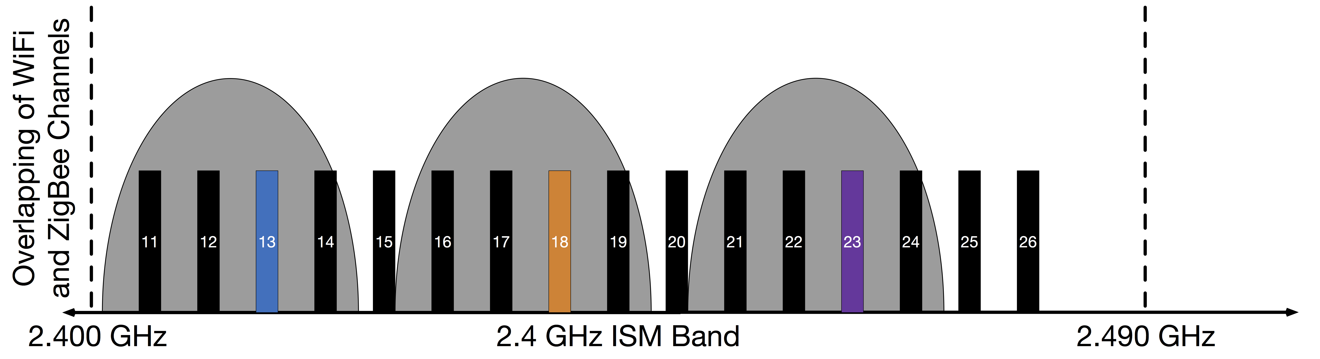

Eliminate Channel Quality Estimation
Randomly pick 3 ZigBee channels that are “far apart”
IPSN 2016
Mobashir Mohammad | NUS
Oppcast

Slide 28
Oppcast
Key Techniques
Eliminate channel quality estimation
Reduce Energy Consumption
Exploit channel diversity
Better Resilience to CTI
Exploit spatial diversity
Reduce end-to-end latency
IPSN 2016
Mobashir Mohammad | NUS
Oppcast
Notes:
The next issue was to exploit all of these channels in an efficient manner to achieve better resilience to CTI…

Slide 29
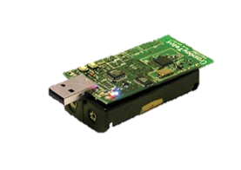
Exploit Channel Diversity
Traditional Channel Hop
Fast Channel Hop
Receiver
Sender
IPSN 2016
Mobashir Mohammad | NUS
Oppcast
Notes:
If we look how a receiver and sender and tries to communicate over multiple channels, it is quite expensive…
However this has a problem of encountering a channel chasing problem. However, our next technique of simultaneously incorporating spatial diversity mitigates this….

Slide 30
Oppcast
Key Techniques
Eliminate channel quality estimation
Reduce Energy Consumption
Exploit channel diversity
Better Resilience to CTI
Exploit spatial diversity
Reduce end-to-end latency
IPSN 2016
Mobashir Mohammad | NUS
Oppcast

Slide 31
Exploit Spatial Diversity
Spatial Diversity Opportunistic routing
Reduces end-to-end packet delivery latency
Causes duplicate packet explosion
IPSN 2016
Mobashir Mohammad | NUS
Oppcast

Slide 32
Exploit Spatial Diversity
Opportunistic routing Spatial Diversity
.
Oppcast incorporates Opportunistic Unicast
IPSN 2016
Mobashir Mohammad | NUS
Oppcast

Slide 33
Oppcast
Channel 1
Channel 2
Channel 3
IPSN 2016
Mobashir Mohammad | NUS
Oppcast

Slide 34
Evaluation
Compared against
RPL/ContikiMAC – Tree-based Data Collection
ORPL – Spatial Diversity
RPL/MiCMAC – Channel Diversity
Testbeds considered
Indriya at NUS : 98 nodes across 3 floors of a building
Urban deployments : 20 nodes
Carpark, Residential Complex, Shopping Mall and Cafeteria.
IPSN 2016
Mobashir Mohammad | NUS
Oppcast

Slide 35
Evaluation
Metrics considered
Reliability
Duty Cycle
Latency
Protocol Parameters
4 mins of Inter-packet Interval
Only interfered channels considered on Testbeds
Random channel selection on Urban Deployments
IPSN 2016
Mobashir Mohammad | NUS
Oppcast

Slide 36
Is only spatial diversity enough?

Slide 37
Is only spatial diversity enough?
All 3 CTI-free
channels
All 3 interfered
channels
Oppcast consistently maintains very high reliability…
IPSN 2016
Mobashir Mohammad | NUS
Oppcast
Notes:
Add the channel used for ORPL/RPL

Slide 38
Is only spatial diversity enough?
All 3 CTI-free
channels
All 3 interfered
channels
While consuming up to 1.2 times lower energy …
IPSN 2016
Mobashir Mohammad | NUS
Oppcast

Slide 39
Is only spatial diversity enough?
All 3 CTI-free
channels
All 3 interfered
channels
And up to 2.7 times lower packet delivery latency…
IPSN 2016
Mobashir Mohammad | NUS
Oppcast

Slide 40
Is only spatial diversity enough?
All 3 CTI-free
channels
All 3 interfered
channels
With up to 6 times reduction in duplicate traffic generation…
IPSN 2016
Mobashir Mohammad | NUS
Oppcast

Slide 41
Is only channel diversity enough?

Slide 42
Is only channel diversity enough?
All 3 CTI-free
channels
All 3 interfered
channels
3X Lower Latency
Oppcast up to 3 times faster than MiCMAC due to opportunistic routing
IPSN 2016
Mobashir Mohammad | NUS
Oppcast

Slide 43
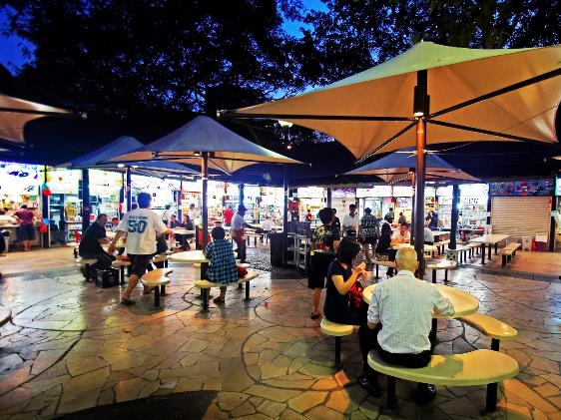
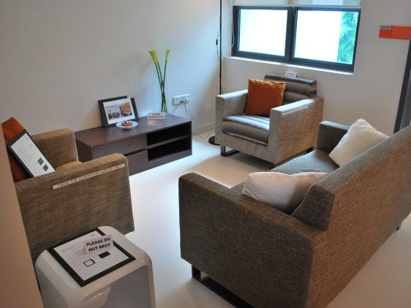
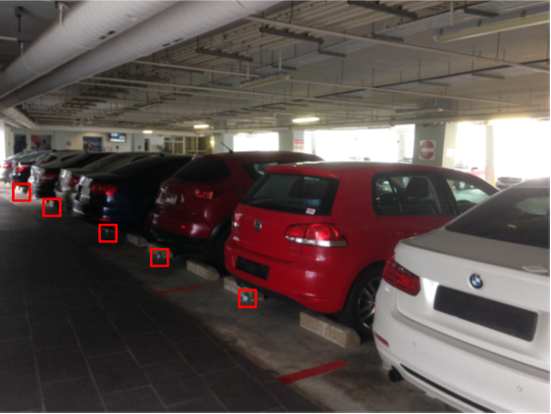
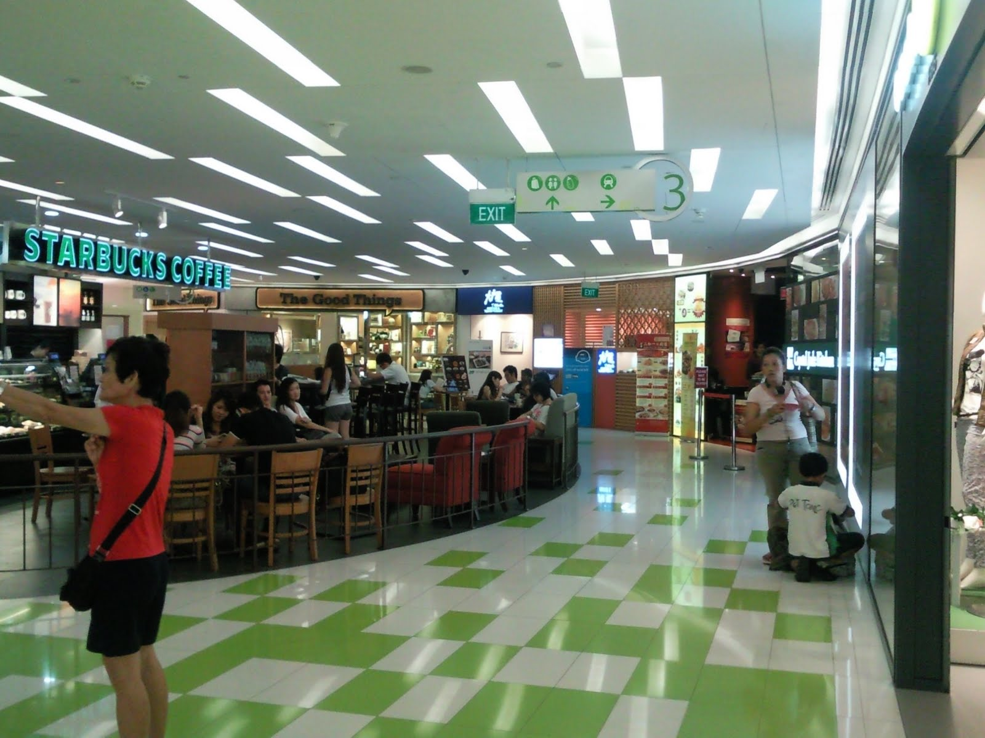
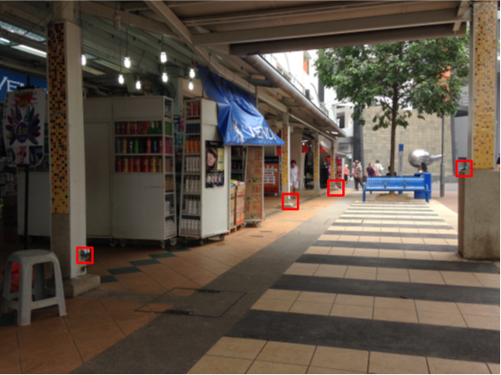
Urban Evaluation
Cafeteria
Residence
Carpark
Inside Shopping Mall
Outside Shopping Mall
IPSN 2016
Mobashir Mohammad | NUS
Oppcast
Notes:
Before heading for outdoor deployment, we chose to stress test Oppcast under controlled settings.

Slide 44
Urban Evaluation
Deployment Location | Protocol | Duration | Min. Reliability | Max. Duty Cycle | Max. Duplicate Traffic
Carpark | ORPL | 181 Hours | 86.09 | NA | 10.60
 | Oppcast |  | 98.55 | NA | 2.55 (4.2X)
Residence | ORPL | 71 Hours | 92.45 | 4.23 | 26.54
 | Oppcast |  | 98.40 | 3.47 (1.2X) | 5.54 (4.8X)
Cafeteria | ORPL | 1 Hour | 99.32 | 4.0 | 17.03
 | Oppcast |  | 100 | 2.6 (1.5X) | 4.05 (4.2X)
Inside Shopping Mall | ORPL | 1 Hour | 99.87 | 9.39 | 47.21
 | Oppcast |  | 100 | 3.96 (2.4X) | 10.61 (4.5X)
Outside Shopping Mall | ORPL | 1 Hour | 99.53 | 7.42 | 12.79
 | Oppcast |  | 100 | 2.82 (2.6X) | 8.64 (1.5X)

Slide 45
Urban Evaluation
Deployment Location | Protocol | Duration | Min. Reliability | Max. Duty Cycle | Max. Duplicate Traffic
Carpark | ORPL | 181 Hours | 86.09 | NA | 10.60
 | Oppcast |  | 98.55 | NA | 2.55 (4.2X)
Residence | ORPL | 71 Hours | 92.45 | 4.23 | 26.54
 | Oppcast |  | 98.40 | 3.47 (1.2X) | 5.54 (4.8X)
Cafeteria | ORPL | 1 Hour | 99.32 | 4.0 | 17.03
 | Oppcast |  | 100 | 2.6 (1.5X) | 4.05 (4.2X)
Inside Shopping Mall | ORPL | 1 Hour | 99.87 | 9.39 | 47.21
 | Oppcast |  | 100 | 3.96 (2.4X) | 10.61 (4.5X)
Outside Shopping Mall | ORPL | 1 Hour | 99.53 | 7.42 | 12.79
 | Oppcast |  | 100 | 2.82 (2.6X) | 8.64 (1.5X)

Slide 46
Urban Evaluation
Deployment Location | Protocol | Duration | Min. Reliability | Max. Duty Cycle | Max. Duplicate Traffic
Carpark | ORPL | 181 Hours | 86.09 | NA | 10.60
 | Oppcast |  | 98.55 | NA | 2.55 (4.2X)
Residence | ORPL | 71 Hours | 92.45 | 4.23 | 26.54
 | Oppcast |  | 98.40 | 3.47 (1.2X) | 5.54 (4.8X)
Cafeteria | ORPL | 1 Hour | 99.32 | 4.0 | 17.03
 | Oppcast |  | 100 | 2.6 (1.5X) | 4.05 (4.2X)
Inside Shopping Mall | ORPL | 1 Hour | 99.87 | 9.39 | 47.21
 | Oppcast |  | 100 | 3.96 (2.4X) | 10.61 (4.5X)
Outside Shopping Mall | ORPL | 1 Hour | 99.53 | 7.42 | 12.79
 | Oppcast |  | 100 | 2.82 (2.6X) | 8.64 (1.5X)

Slide 47
Conclusion
Observed that an urban deployment is quite challenging due to severe CTI
Designed Oppcast, a robust data collection protocol eliminating the need of channel quality estimation
Achieves more than 98.55% reliability during 255 hours of evaluation in different urban environments
Spatial and Channel Diversity
IPSN 2016
Mobashir Mohammad | NUS
Oppcast

Slide 48

IPSN 2016
Mobashir Mohammad | NUS
Oppcast

Slide 49
References
Seoul Food Street: https://i.ytimg.com/vi/lPG0VfAJpZc/maxresdefault.jpg
Singapore Mall: https://i.ytimg.com/vi/aMZx2C8YDsU/maxresdefault.jpg
Hong Kong Residence: http://www.chinasmack.com
Greenorbs: http://www.cs.ust.hk/~liu/GreenOrbs2011.pdf
Golden Gate: http://cdn.history.com/sites/2/2015/05/hith-golden-gate-144833144-E.jpeg
Zebra: http://weknowyourdreamz.com/image.php?pic=/images/zebra/zebra-02.jpg
Volcano: http://www.volcano-erasmusplus.eu
Water Reservoir: http://www.ntu.edu.sg/home/limo/papers/sensys14-final15.pdf
Telosb: http://www.willow.co.uk/html/telosb_mote_platform.php

Slide 50
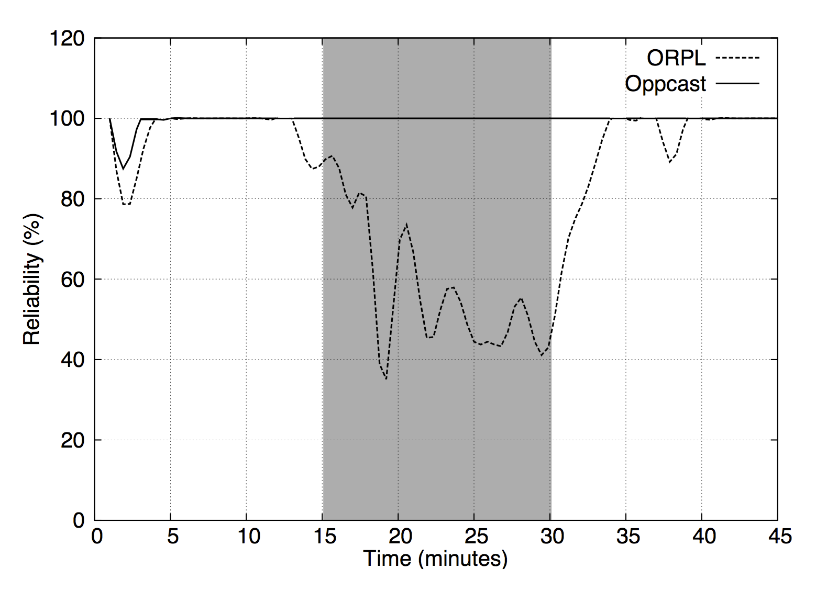
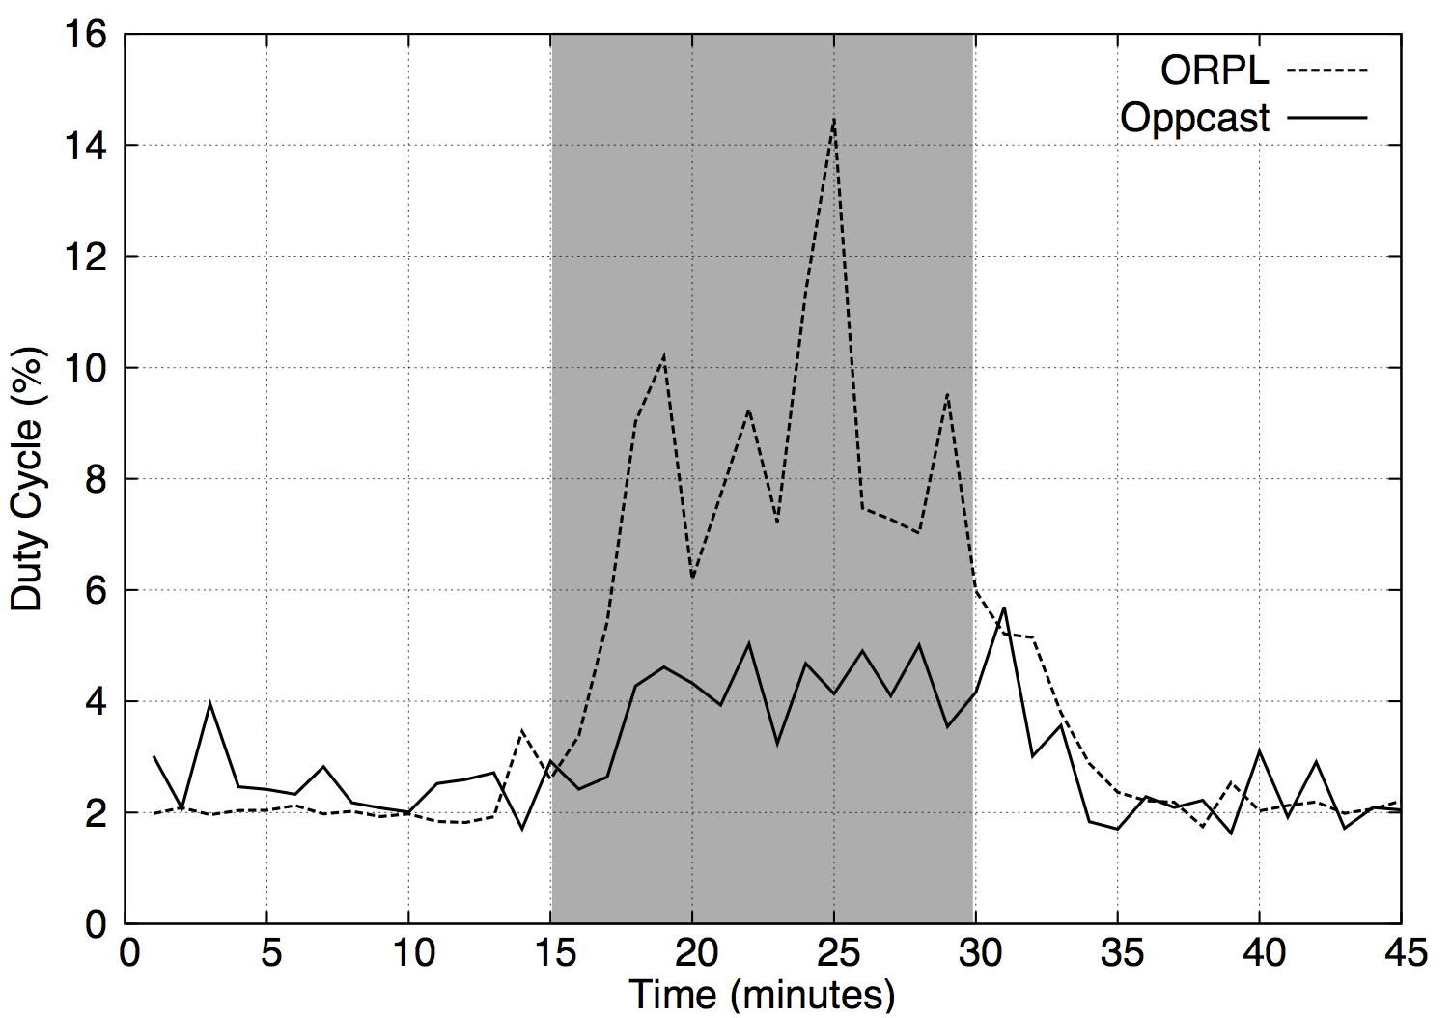
Discussion: Stress Testing
Oppcast can withstand severe WiFi interference with reduced energy
IPSN 2016
Mobashir Mohammad | NUS
Oppcast
Notes:
Before heading for outdoor deployment, we chose to stress test Oppcast under controlled settings.

Slide 51
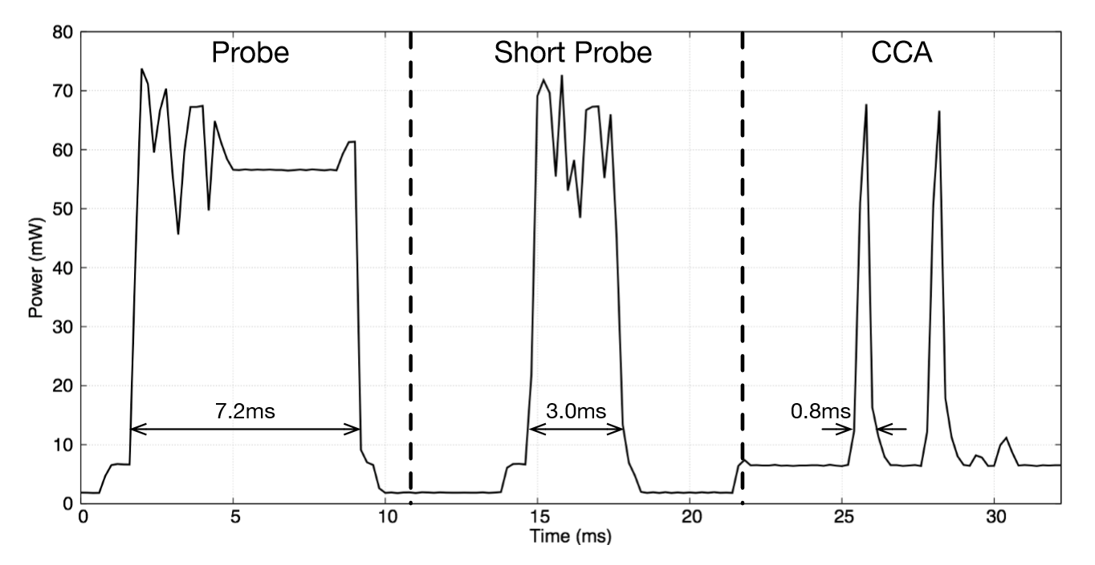
Discussion: Base power consumption
IPSN 2016
Mobashir Mohammad | NUS
Oppcast

Slide 52
Discussion: Network Density
Number of Neighbors on Interference free Channel
IPSN 2016
Mobashir Mohammad | NUS
Oppcast

